Slide 1
Online retail generated $10.67M in positive sales value
Sales performance, customer behavior, and data-quality findings for business owners and stakeholders.
Key takeaway: growth signals are visible, but decision quality depends on cleaner classifications and validated reporting periods.
Notes:
Open with the scale of the analysis: $10.67M in positive sales value. The findings show visible growth signals, while cleaner classifications and validated reporting periods remain essential to decision quality.

Slide 2
Five findings frame the business decision
1
Scale
$10.67M across 19,960 positive-sales invoices.
2
Concentration
The UK contributed 84.61% of positive sales value.
3
Momentum
November 2011 was the strongest month at $1.51M.
4
Data risk
135,080 raw rows lack CustomerID.
Source: Online Retail Final Analysis Report. Findings are decision inputs, not standalone recommendations.
Notes:
Walk through scale, concentration, momentum, and data risk. These findings frame the decision; they do not replace validation of reporting periods or classifications.

Slide 3
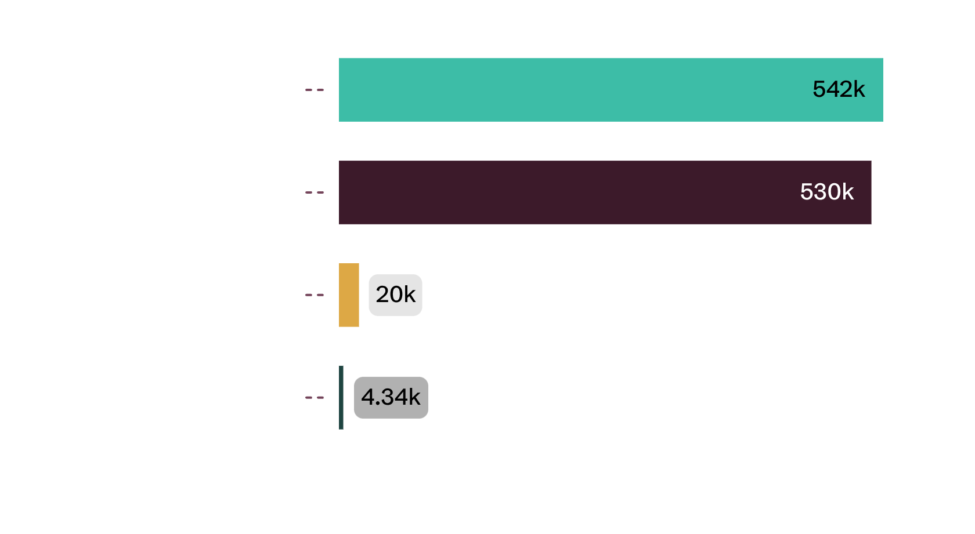
The analysis creates a consistent positive-sales baseline
01
Exhibit Analytical baseline from raw transactions to identified customers
Positive sales: Quantity > 0 and UnitPrice > 0.
Customer metrics: non-missing CustomerID values.
Important boundary: sales value is not profit. Cost, margin, inventory, and marketing data were unavailable.
Source: Online Retail Final Analysis Report. Baseline funnel uses the supplied report attachment.
Notes:
The baseline narrows the raw dataset into positive-sales lines, invoices, and identified customers. Customer metrics exclude missing CustomerID values. Sales value should not be read as profit.

Slide 4
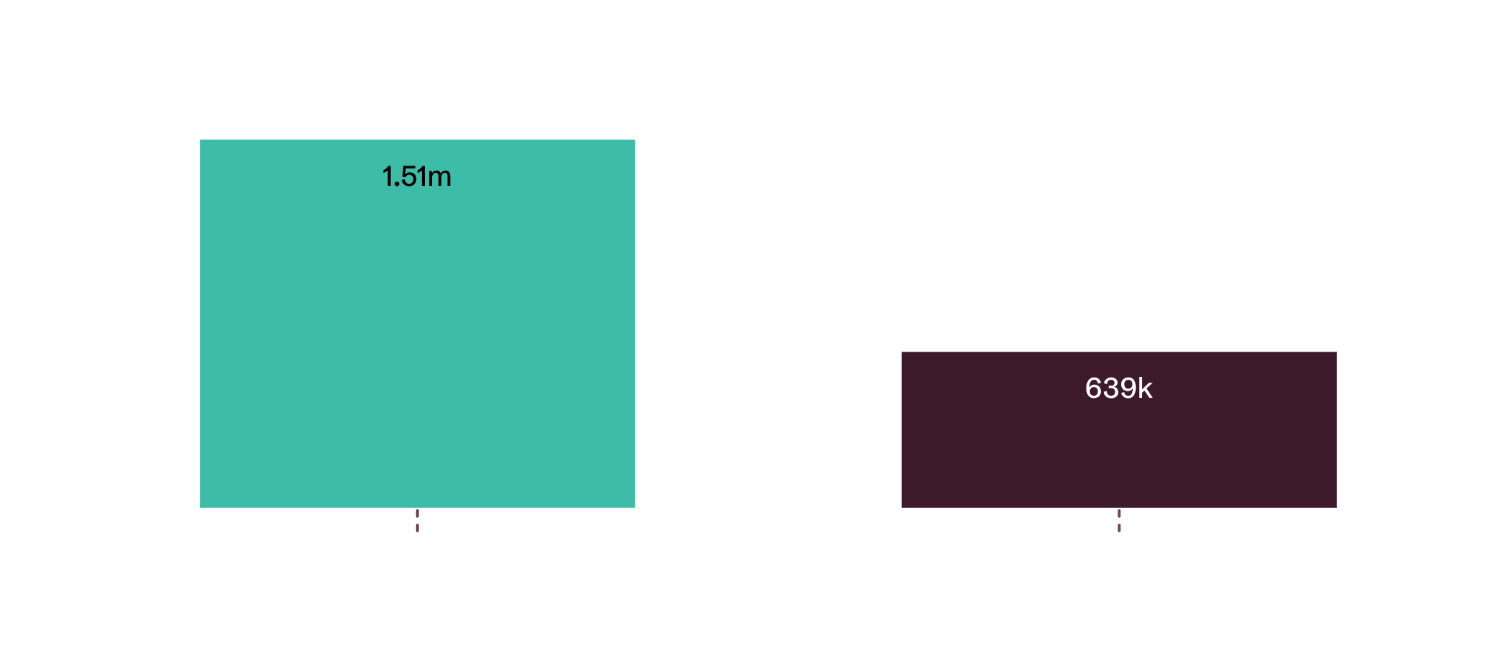
Sales peaked in November, with December requiring a completeness check
02
Exhibit Monthly positive sales trend
So what
November leads. $1,509,496.33 is the highest monthly value.
December needs validation. Confirm the reporting period is complete before calling the drop seasonal.
Read: September and October also showed strong positive sales. December is materially lower than November, but do not interpret it as seasonality until period completeness is confirmed.
Source: Online Retail Final Analysis Report. December completeness remains an open question.
Notes:
Point first to November's $1,509,496.33, then to December's $638,792.68. The gap is material, but completeness must be confirmed before drawing a seasonal conclusion.

Slide 5
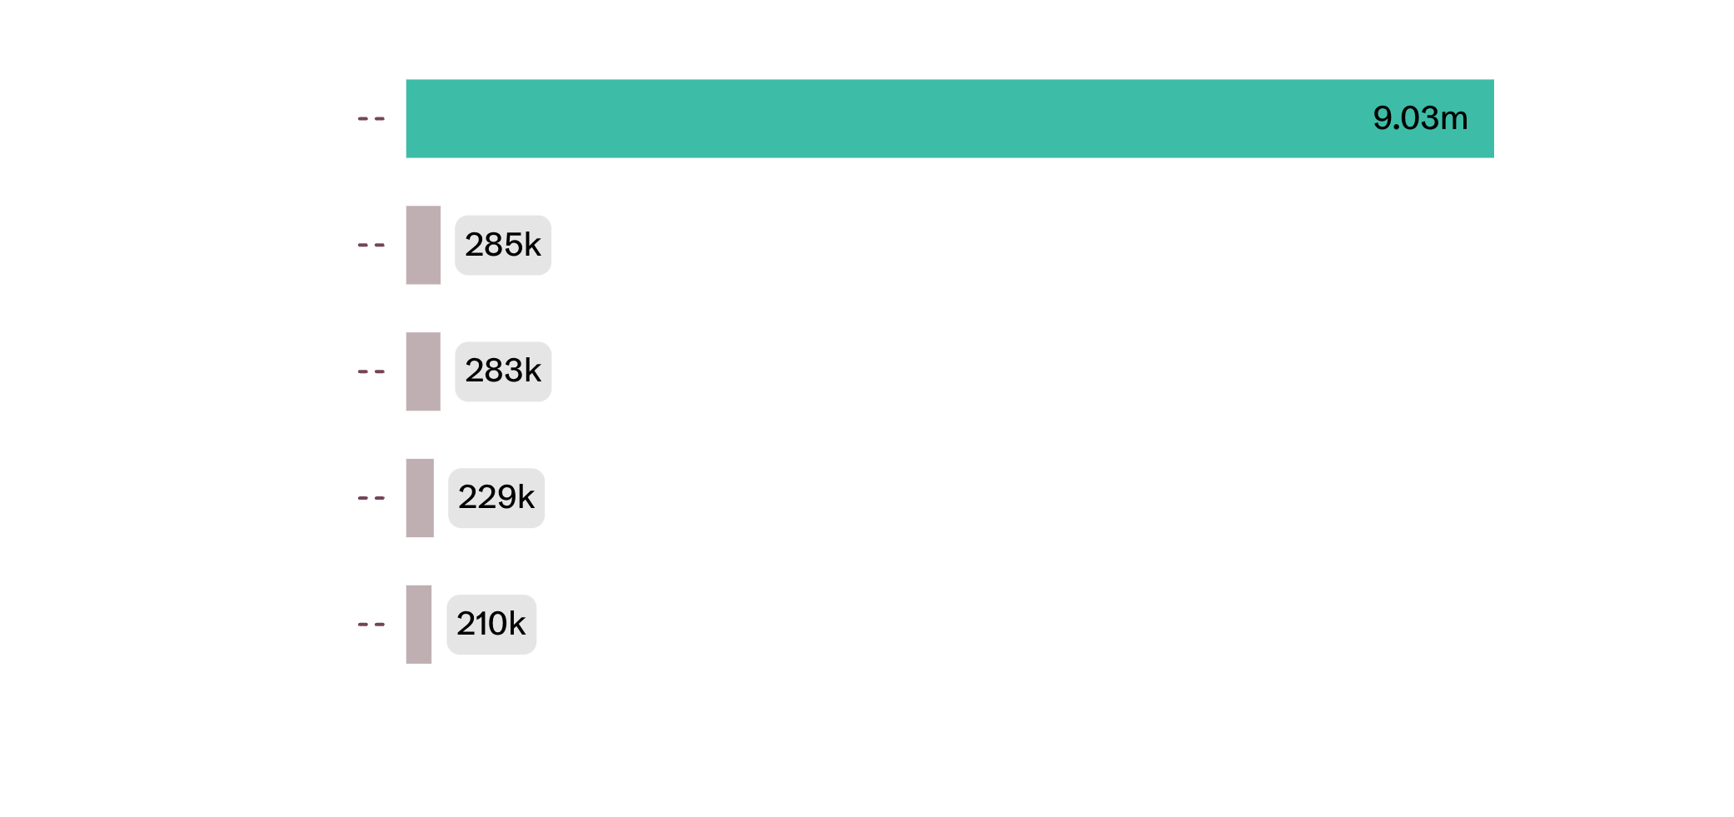
UK concentration is the clearest strategic exposure
03
Exhibit Country contribution to positive sales value
Exposure
United Kingdom: $9.03M, or 84.61%.
Netherlands: $285K, or 2.68%.
EIRE: $283K, or 2.66%.
Germany: $229K, or 2.15%.
France: $210K, or 1.97%.
Compare customer counts, repeat purchase, shipping cost, and margin before recommending expansion.
Source: Online Retail Final Analysis Report. The UK contributes 84.61%; each next market is below 3%.
Notes:
The UK dominates the baseline. The next four markets each contribute less than 3%, so expansion should be assessed through customer counts, repeat purchase, shipping cost, and margin.

Slide 6
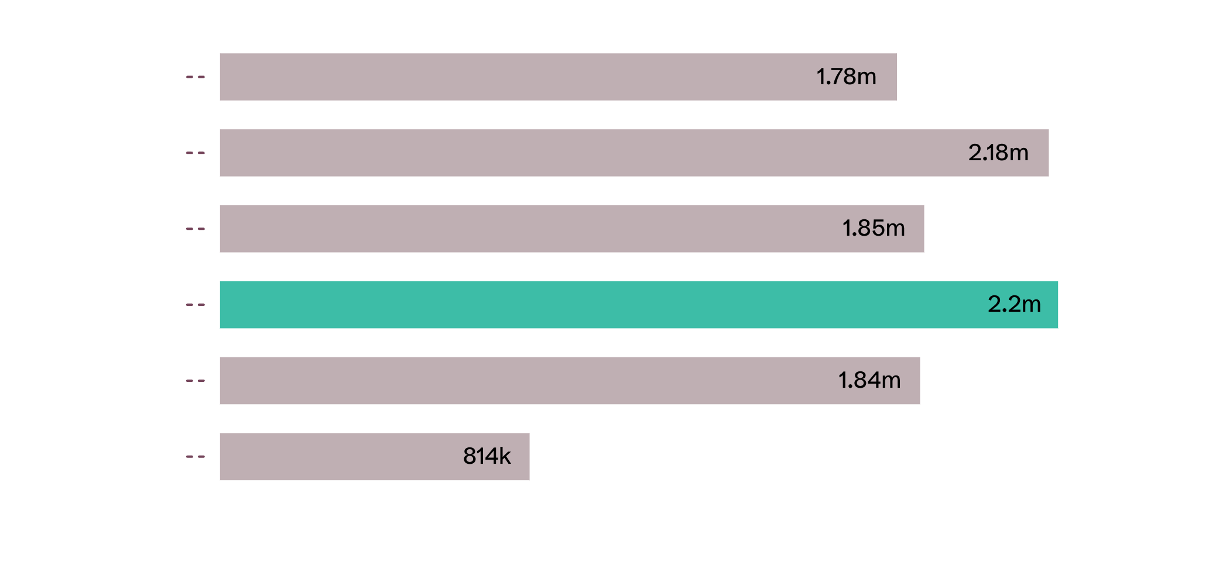
Thursday and midday are the strongest operating windows
04
Exhibit Weekday positive sales value
Operating read
Thursday leads: $2.20M.
Tuesday follows: $2.18M.
Sunday trails: $0.81M.
Top hours: 10:00 and 12:00.
Use these as staffing hypotheses, not final capacity decisions.
Source: Online Retail Final Analysis Report. The supplied analysis also identifies 10:00 and 12:00 as the top sales hours.
Notes:
Thursday and Tuesday lead weekday sales, while Sunday trails materially. The top sales hours are 10:00 and 12:00. Treat these as staffing hypotheses, not final capacity decisions.

Slide 7
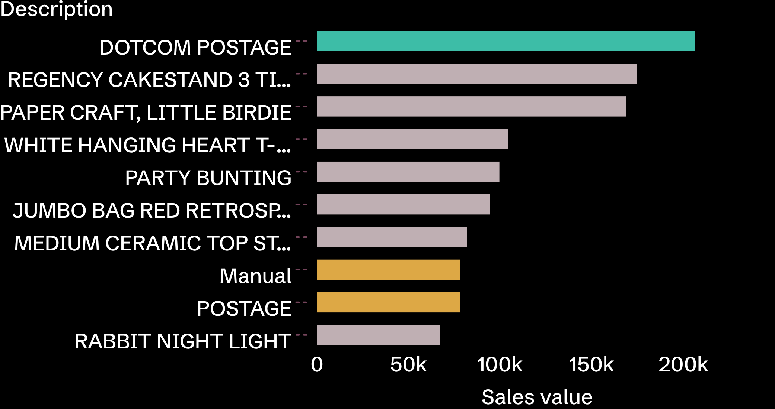
Top-selling descriptions mix merchandise with service-like codes
05
Exhibit Top product descriptions by sales value
Merchandising caution
DOTCOM POSTAGE led at $206K.
REGENCY CAKESTAND 3 TIER generated $174K.
PAPER CRAFT, LITTLE BIRDIE generated $168K.
POSTAGE and Manual also appear in the top 10.
Classify postage, manual, and service-like codes separately before making assortment decisions.
Source: Online Retail Final Analysis Report. Gold marks service-like codes requiring separate classification.
Notes:
The ranking is commercially useful, but it mixes merchandise with postage, manual, and service-like codes. Separate those codes before using the ranking to guide assortment decisions.

Slide 8
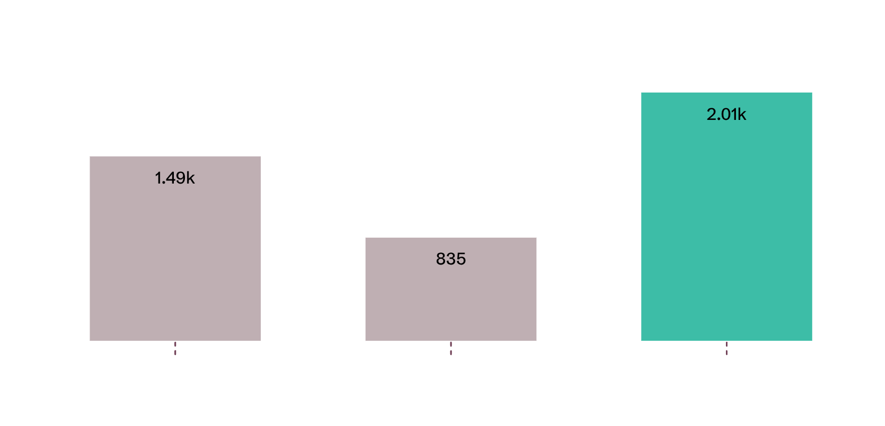
06
Repeat purchasing is a meaningful signal, not yet retention proof
Exhibit Invoice frequency among identified customers
Source: Online Retail Final Analysis Report. Percentages use 4,338 identified customers.
Customer signal
4,338 identified customers have usable CustomerIDs.
2,010 placed 3+ invoices, or 46.3%.
835 placed 2 invoices, or 19.2%.
1,493 placed 1 invoice, or 34.4%.
Next analysis: time between purchases, cohorts, and customer lifetime value.
Notes:
Nearly half of identified customers appear in the 3+ invoice segment. That is a meaningful repeat-purchasing signal, but retention proof requires time between purchases, cohorts, and customer lifetime value.

Slide 9
Data-quality exceptions are material enough to manage operationally
24.93%
10,624
9,288
Missing CustomerID
Negative quantity
C-prefixed invoices
135,080 raw rows.
Rows requiring interpretation.
Rows in the supplied audit.
2,515
1,501
Zero unit price
Blank or “?” description
Rows requiring classification.
1,454 blank; 47 “?”.
Source: Online Retail Final Analysis Report. Exception categories overlap; never sum them as unique affected rows.
Operational implication: manage exception categories explicitly, but preserve the overlap between them when sizing remediation.
Notes:
The largest exception is missing CustomerID at 24.93% of raw rows. Negative quantity, C-prefixed invoices, zero unit price, and incomplete descriptions are also material. Because categories overlap, their counts cannot be summed as unique affected rows.

Slide 10

Exceptions need classification before exclusion
Negative quantity can represent cancellations, returns, adjustments, or damaged goods.
All C-prefixed invoice rows had negative quantities in the supplied audit.
1,336 negative-quantity rows lacked a C prefix and also had zero price and missing CustomerID.
The 1,336-row interpretation is a hypothesis for investigation, not a confirmed classification.
Source: Online Retail Final Analysis Report.
Keep exception records visible while source teams validate their meaning.
Notes:
Do not exclude exceptions simply because they look unusual. Negative quantity can mean several things. The supplied audit gives a useful 1,336-row hypothesis, but it remains a hypothesis. Keep exception records visible while source teams validate their meaning.

